Slide 1

Cloud Workshop
Cloud Technology Essentials

Slide 2


Welcome
Networking
1
2
Cloud
Deployment
3
4
Breakout
More on Cloud
5
6
Q & A

Slide 3
?
What did just happened?

Slide 4




Networking
Essential Basics
How information is transmitted over computer networks, network architecture, HTTP, APIs, and web applications
Notes:
Please, replace the image with a more suitable. Avoid removing the blue shape!

Slide 5

Networking Objectives
🥚 Basic
🥚 Layers of Networking
🥚 Data exchange in the Internet
🥚 Web application
✔️ Advanced
✔️ Application layer requests and responses, GET & POST ✔️ API
✔️ Flask

Slide 6
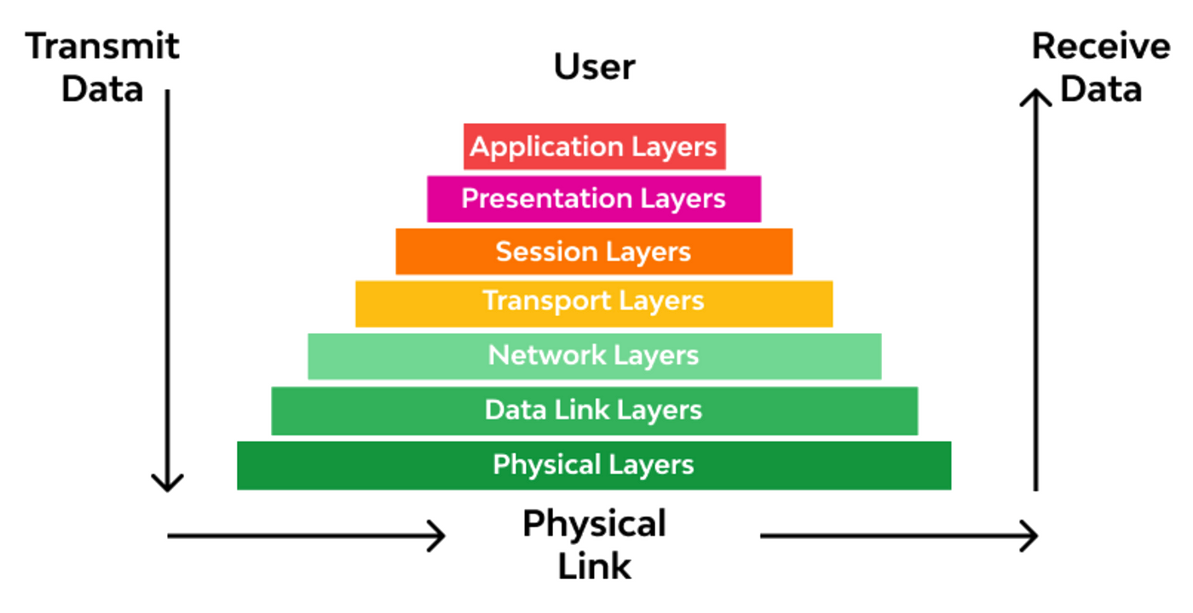
Layers of Networking

Slide 7
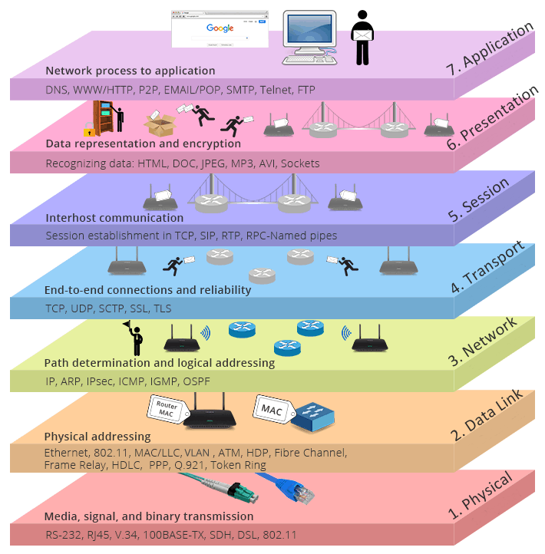


Slide 8
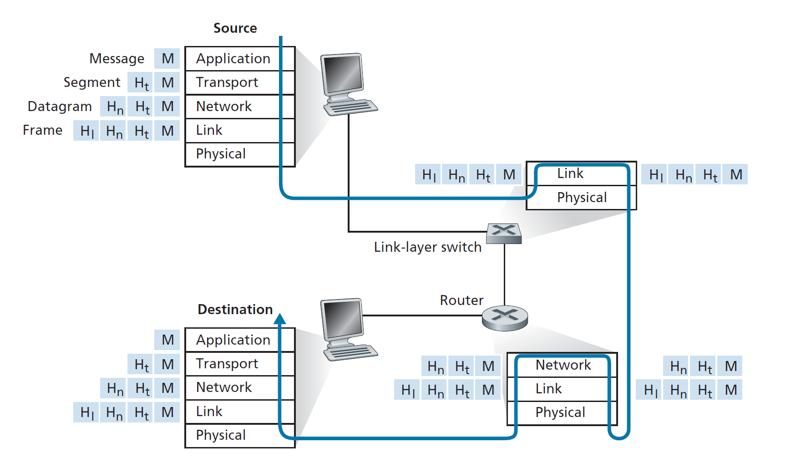

Slide 9
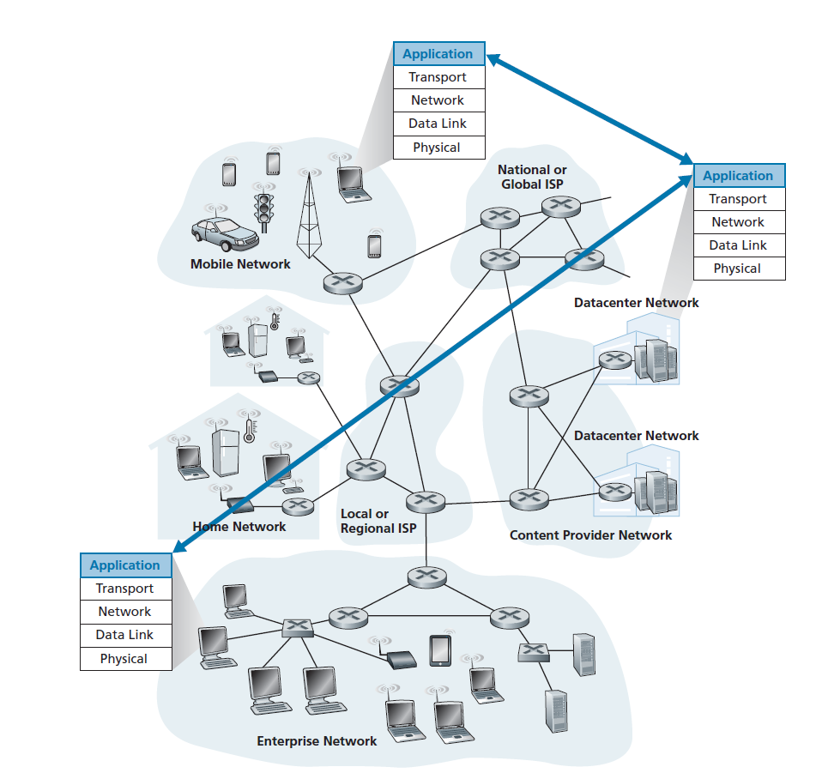

Network Architecture

Slide 10
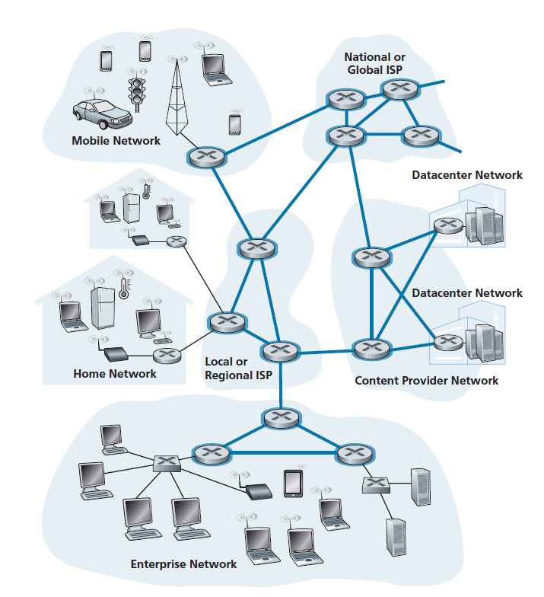

Slide 11
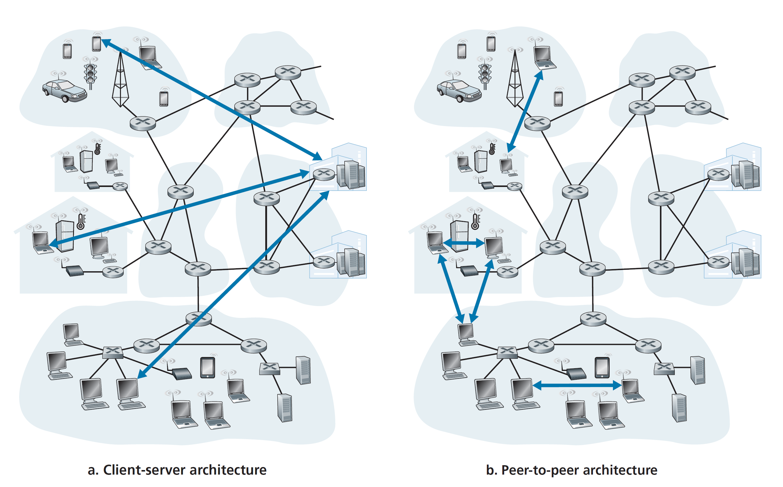

Slide 12
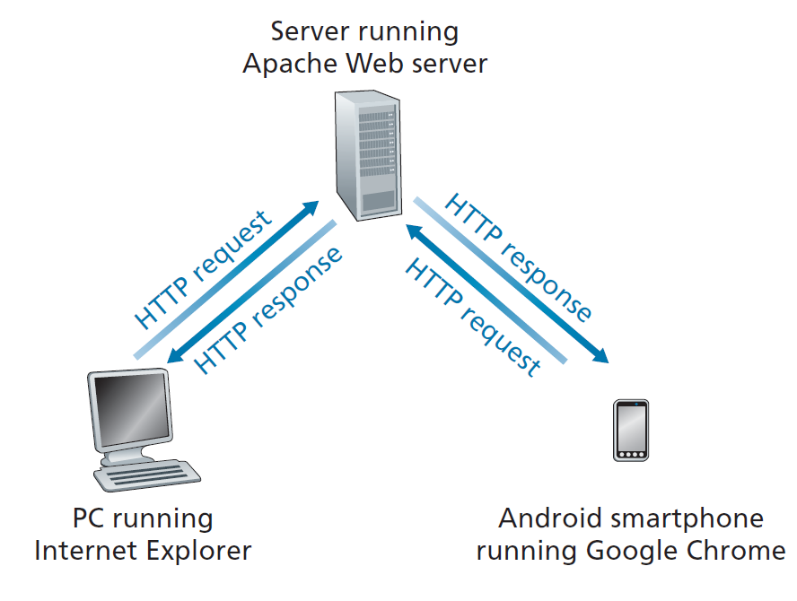
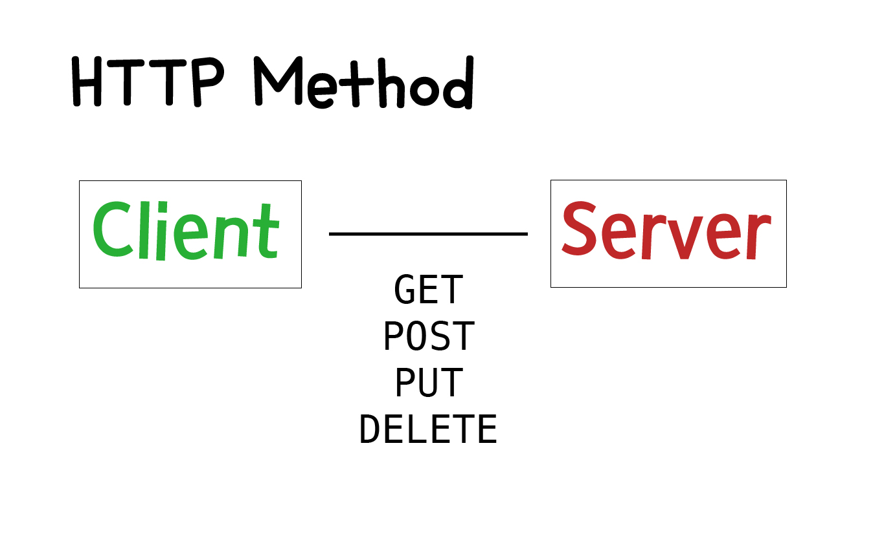
Request - Response

Slide 13
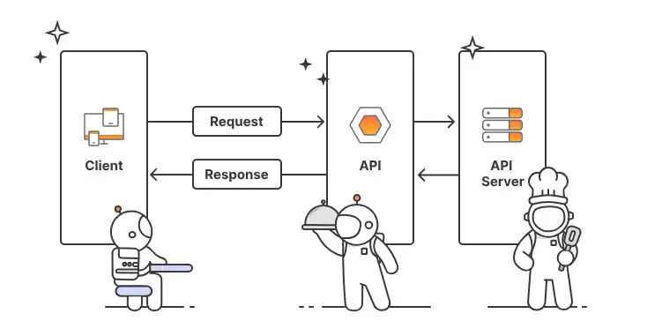
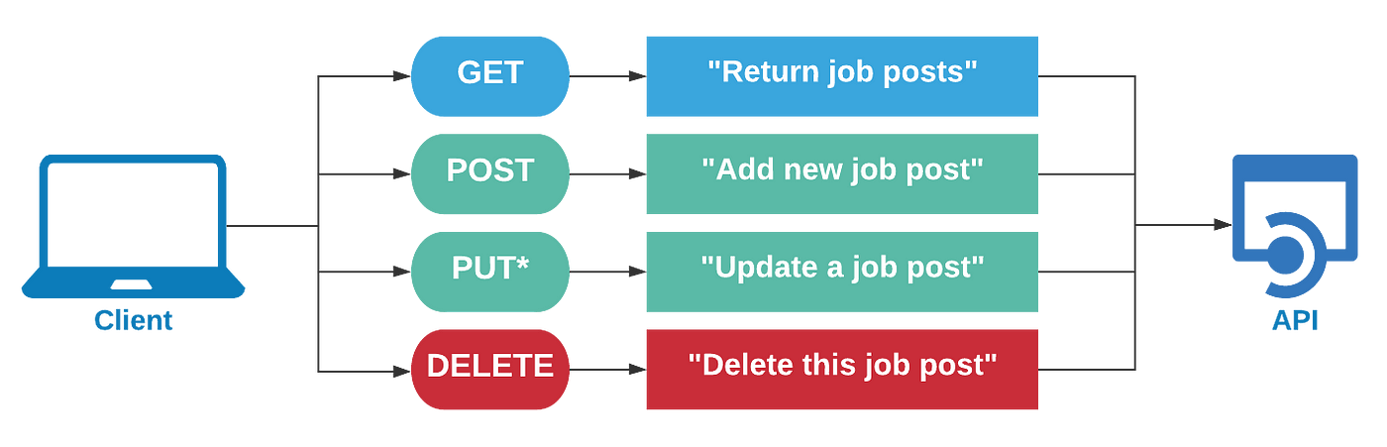
API

Slide 14
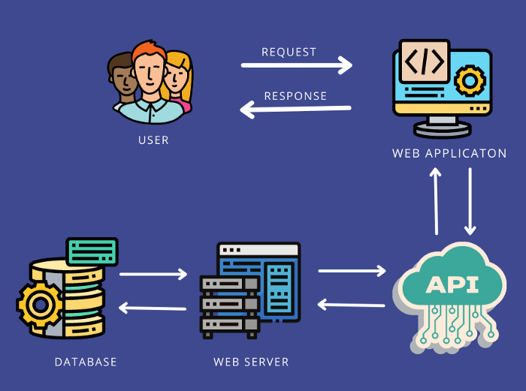
Web Application

Slide 15
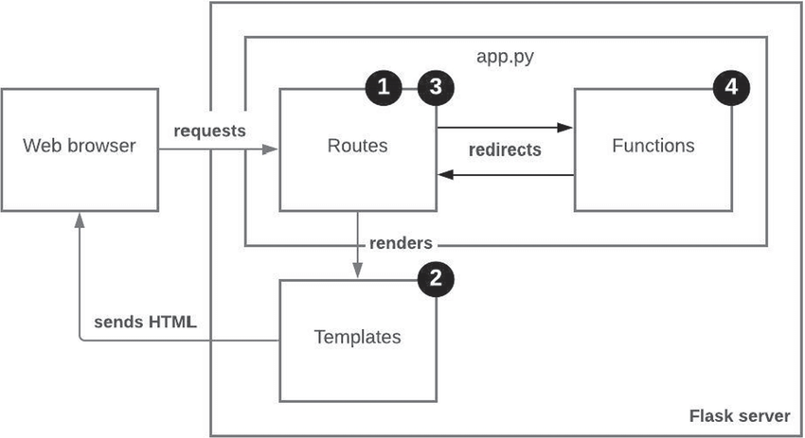
Flask
Flask is a Python framework for web application

Slide 16
“
If you are a data scientist do you need to know about networking?
Discussion

